Slide 1
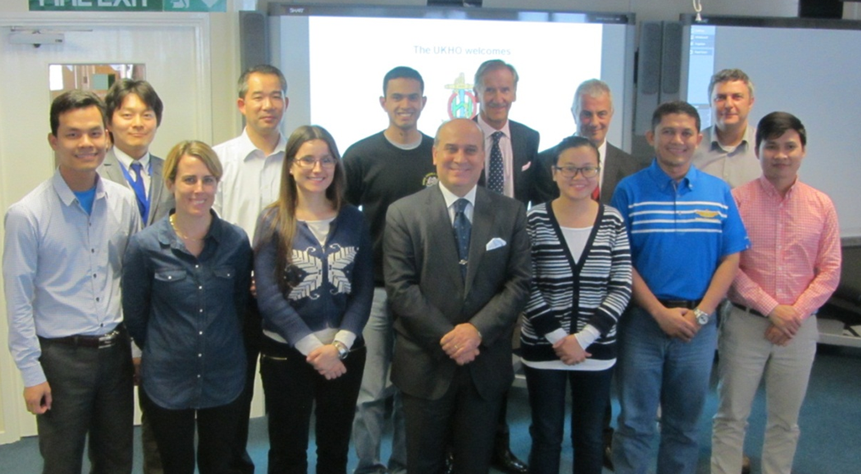
Title
IHO – NIPPON FOUNDATION
ALUMNI SEMINAR
Li San Nancy Yang
Suriname
Alumnae of 6th Training Course in Hydrography Data Processing and Marine Cartography 2014

Slide 2
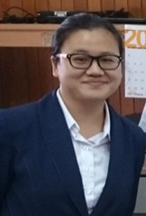
Self introduction
IHO – NIPPON FOUNDATION
ALUMNI SEMINAR
Name | Li San Nancy Yang
Alumni year | 2014
Country | Suriname
Organization | Maritime Authority Suriname (MAS)
Position/Job title | Cartographer and hydrographic technician 1st class.
Current job description | Providing Hydrographic Assistance and Cartographic work producing Paper Charts and ENC.

Slide 3
My career path and projects / Achievements
IHO – NIPPON FOUNDATION
ALUMNI SEMINAR
2009: started working at the Hydographic Office of the MAS
2014: Attended the 6th Training Course in Hydrogaphy Data Processing and Marine Cartography, UKHO (CHART Project)
2015: Established Sub department Cartography at the MAS
Chart production workflow and standards implemented
Upgrade Hydrographic department in data management
Training other personnel
Since 2017 lecturer on cartographic subjects during IALA AtoN Manager level 1 course in Suriname.
Self Production and Maintenance of Paper Charts
MAS – UKHO: already produced 3 new charts. The INT Chart 4191 is compiled by MAS. 1 chart in the planning.
Production ENC band 6: specifically produced to use on the Portable Pilot Unit for the pilots. (ongoing).
Other purposes charts: Maritime Boundaries and Limits Chart of Suriname, Met Ocean Chart for the National Institute for Environment and Development in Suriname, charts produced for the commercial fisheries, special charts produced for Pilot training etc.
Suriname is since 2019 Chair of the MACHC International Charting Coordination (MICC) Working Group. Provide technical assistance.

Slide 4
Lessons learned from CHART Course
IHO – NIPPON FOUNDATION
ALUMNI SEMINAR
Cartography in its entirety.
Close cooperation, good teamwork
Experienced UKHO Training Team
International friendships!

Slide 5
Suggestion for the future
IHO – NIPPON FOUNDATION
ALUMNI SEMINAR
Refresher training
Special training course for the S-100 era & High Density ENC

Slide 6
IHO – NIPPON FOUNDATION
ALUMNI SEMINAR
Special thanks to IHO and NIPPON Foundation for the given opportunities.
Thank you all for your attention!
nyang@mas.sr

